Slide 1
CHAPTER 5: computer and cyber crime
DR. ROZI NOR HAIZAN
BINTI NOR

Slide 2
objectives
Describe and categorize cybercrimes or cyber-related crimes
Distinguish cyber-related crimes and cyber-exacerbated crimes
Knows who the perpetrators are
State the different kinds of crimes
Know the related Law
Know effort to combat such crimes

Slide 3
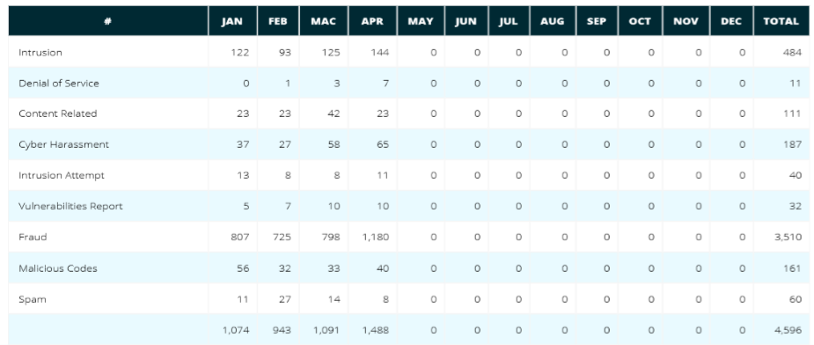
Introduction
Reported Incidents based on General Incident Classification Statistics 2020
https://www.mycert.org.my

Slide 4
Malaysia cybercrime cases

Slide 5
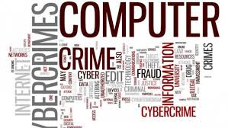
Defining Cybercrime
Confusion in labeling “computer crimes”
computer crime ⬄ cybercrime
Computer crime definition:
The act of criminal using computer all a tool

Slide 6
Defining Cybercrime
(genuine) Cybercrime definition:
A crime in which the criminal act can be carried out only through the used of cybertechnology and can take place only in the cyberrealm
Notes:
Cyber Technology refers to the set of tools, systems, and technologies used in the digital or virtual world, often involving the internet or networks.
Cyber realm refers to activities or phenomena that occur exclusively within the virtual or digital space, not in the physical world.

Slide 7
Categories of Genuine Cybercrime
Cyberpiracy : using cybertechnology in unauthorized ways to:
Reproduce copies or proprietary software and proprietary information or
Distribute proprietary information (in digital form) across a computer network
Eg: the distribution of MP3 files that contain proprietary material

Slide 8
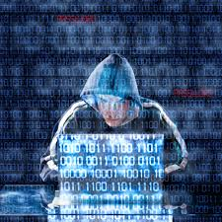
Categories of Genuine Cybercrime
Cybertrespass : using cybertechnology to gain unauthorized access to:
An individual’s or an organization’s computer system or;
A password-protected web site
Eg. Denial-of-service attacks on a e-commerce web site

Slide 9
Categories of Genuine Cybercrime
Cybervandalism : using cybertechnology to unleash one or more programs that:
Disrupt the transmission of electronic information across one or more computer networks, including the Internet, or
Destroy data resident in a computer or damage a computer system’s resources, or both
Eg. Unleashing the ILOVEYOU virus

Slide 10
Cyber-EXACERBATED Crimes
Cyber-exacerbated crimes
Cybertechnology does much more than merely assist someone in carrying out a crime
Example : cyberstalking, internet pedophilia, internet pornography
Notes:
Cyberexacerbated crime refers to a crime that is made worse or easier to commit because of the use of technology, especially the internet. It happens when criminals use online tools, social media, or other digital resources to:

Slide 11
Cyber-ASSISTED Crimes
Cyber-assisted crimes
Cybertechnology merely assist someone in carrying out a crime
Example : income tax cheating, physical attack with a computer, property damage using a computer
Notes:
Cyber-Assisted Crime: Cyber-assisted crime is when technology or the internet helps someone commit a crime, but the crime itself could still happen without it. cyber-assisted crime is when digital tools make committing a crime easier or more efficient.

Slide 12
Type of Perpetrators
Hackers
Individuals who test the limitations of systems out of intellectual curiosity to see whether can gain access and how far they can go
Crackers
Break into other people’s networks and system, deface web pages, crash computers, spread harmful programs

Slide 13
Type of Perpetrators
Malicious Insiders
An ever-present adversary (number one concern)
Estimated 70% network intruders come from inside:
Employees, consultants, contractors
Motivated by financial gain, revenge on employers, or publicity

Slide 14
Type of Perpetrators
Malicious Insiders -- cont
Has knowledge of system and authorized to access the systems
Know procedure to gain access to login ids and password
Know how systems work and where the weak points are
Know about organizational structure and security procedure to avoid any investigation

Slide 15
Type of Perpetrators
Industrial spies
Use illegal means to obtain trade secrets from the competitors of the firm for which they are hire
Theft of trade secret by disgruntled employees or ex-employees

Slide 16
Type of Perpetrators
Cybercriminal
Hack into corporate computer and steal money often transferring money from one account into another
Engage in all forms of computer fraud
Can spend large sum of money to but expertise and access

Slide 17
Type of Perpetrators
Cyberterrorists
Someone who intimidates or coerces a government or organization to advance his or her political or social objectives by launching computer-based attacks against computers, networks, and information stored on them
Cause harm rather than to gather information
Result in outright destruction or disruption of services
Can be well-organized, well-trained, and well-supported

Slide 18
Fraud, Embezzlement, Sabotage, Identity theft, and forgery
Some causes of Fraud
Credit-Card
Stolen receipts, mailed notices, and card
Interception of online transaction or weak e-commerce security
Careless handling by card-owner
ATM
Stolen account numbers and PINs
Insider knowledge
A counterfeit ATM

Slide 19
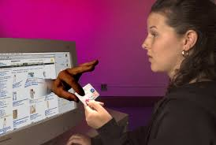
Fraud, Embezzlement, Sabotage, Identity theft, and forgery
Embezzlement and Sabotage
Some causes
Insider information
Poor security
Complex financial transaction
Anonymity of computer users
Some defenses
Rotate employee responsibility
Require use of employee ID and password
Implement audit trail
Careful screening and background checks of employees

Slide 20
Fraud, Embezzlement, Sabotage, Identity theft, and forgery
Identity Theft
Some causes
Insecure and inappropriate use of identification card number
Careless handling of personally identifiable information
Weak security of stored records
Insufficient assistance to identity theft
Some defenses
Limit use of personally identifiable information
Increase security of information stored by business and government agencies
Improve methods to accurately identify a person
Educate consumers

Slide 21
Fraud, Embezzlement, Sabotage, Identity theft, and forgery
Forgery
Some causes
Powerful computers and digital manipulation software
High-quality printers, copiers, and scanners
Some defenses
Educate consumers and employees
Use anti-counterfeiting techniques during production
Use counterfeit detection methods
Create legal and procedural incentives to improve security

Slide 22
CYBERCRIME in Malaysia
Cybercrime has surpassed drug trafficking as the most lucrative crime.
Almost anybody who is an active computer/ online user would have been a cybercrime victim, and in most cases too its perpetrators.
The younger generation are the most vulnerable.
Use of technology to cheat, harass, disseminate false information.
70 % of commercial crime cases now can be categorised as cybercrime cases.
Ref:
Cybercrime: Malaysia Document
DSP Mahfuz bin Dato’ Ab. Majid
Royal Malaysia Police

Slide 23
Current Challenges in cybercrime investigation : Royal Malaysian police

Slide 24
Computer Crimes Act 1997
Date of coming into operation: 1/6/2000
Purpose: to provide punishment related to computer misuse
The law gives enforcer a framework to define:
Reading, overtaking, and using computer together with computer information illegally
Standard for service providers
Outlines punishment to those guilty
The mentioned crimes include:
Trespassing
Steal and destroy data
Deface of web pages
Steal e-mail
Misuse of credit card for fraud

Slide 25
Computer Crimes Act 1997
Cybercrime on property :
steal information, money, service.
Consists of fraud, forgery, mischief
Examples are:
Using statement and wrongly interpret to persuade the country to give property and valuables such as multilevel marketing, franchise, auction through computer
Spreading of computer virus through downloaded programs or email attachment
Illegal access computer systems with intention to destroy or disrupt information

Slide 26
Computer Crimes Act 1997
Cybercrime on human:
Examples are:
Pornography, cyber disturbance in which victims are disturbed through internet via web pages, e-mail or chat
Stalking to threaten victims via e-mail message
Illegal access computer systems with intention to destroy or disrupt information

Slide 27
Computer Crimes Act 1997
Cyber terrorist
Examples are:
Accessing air traffic control to detour flight route to cause crashes
Remote access to food manufacturing system by changing the level of iron that can cause death to children

Slide 28
Computer Crimes Act 1997
Three mains' offences:
Unauthorized access to computer material, Section 3
Unauthorized access with intent to commit or facilitate commission of further offence, Section 4
Unauthorized modification of the contents of any computer, Section 5

Slide 29
Computer Crimes Act 1997
Unauthorized access to computer material:
Section 3(1), a person shall be guilty of an offence if:
He causes a computer to perform any function with intent to secure access to any program or data held in any computer
The access he intends to secure is unauthorized; and
He knows at the time when he causes the computer to perform the function that is the case.
Fine not exceeding RM50,000 or imprisonment for a term not exceeding five years or both

Slide 30
Computer Crimes Act 1997
Unauthorized access with intent to commit or facilitate commission of further offence
Section 4, a person shall be guilty of an offence if he commits an offence referred to in section 3 with intent:
To commit an offence involving fraud or dishonesty or which causes injury as defined in the Penal Code [Act 574]; or
To facilitate the commission of such an offence whether by himself or by any other person
It is immaterial whether the offence is to be committed at the same time when the unauthorized access is secured or on any future occasion
Fine not exceeding RM150,000 or imprisonment for a term not exceeding ten years or both

Slide 31
Computer Crimes Act 1997
Unauthorized modification of the contents of any computer:
Section 5, a person shall be guilty of an offence if he does any act which he knows will cause unauthorized modification of the contents of any computer
Section 2(7), a modification of the contents of any computer takes place if, by the operation of any function of the computer concerned or any other computer -
a) any program or data held in the computer concerned is altered or erased
b) any program or data is introduced or added to its contents; or
c) any event occurs which impairs the normal operation of any computer
And any act that contributes towards causing such modification shall be regarded as causing it

Slide 32
Computer Crimes Act 1997
Unauthorized modification of the contents of any computer
Any modification is authorized if, 2(8)
a) a person whose act causes it is not himself entitled to determine whether the modification should be made; and
b) he does not have consent to the modification from any person who is so entitled
And any act that contributes towards causing such modification shall be regarded as causing it

Slide 33
Computer Crimes Act 1997
Wrongful communication, Section 6
A person shall be guilty of an offence if he communicates directly or indirectly a number, code, password or other means of access to a computer to any person other than a person to whom he is duly authorized to communicate
Fine not exceeding RM25,000 or imprisonment for a term not exceeding three years or both

Slide 34
Computer Crimes Act 1997
Abetments and attempts punishable as offences, Section 7
A person who abets the commission of or who attempts to commit any offence shall be guilty of that offence
A person who does any act preparatory to or in furtherance of the commission of any offence shall be guilty of that offence

Slide 35
Computer Crimes Act 1997
Presumption, Section 7
A person who has in his custody or control any program, data or other information which is held in any computer or retrieved from any computer which he is not authorized to have in his custody or control shall be deemed to have obtained unauthorized access to such program, data or information unless the contrary is proved

Slide 36
CYBERLAWS OF MALAYSIA
1.COMPUTER CRIME ACT 1997
2.COMMUNICATIONS AND MULTIMEDIA ACT 1998 (CMA)
3.MALAYSIAN COMMUNICATIONS AND MULTIMEDIA COMMISSION ACT 1998
4.DIGITAL SIGNATURE ACT 1997
5.COPYRIGHT ACT (AMENDMENT) 1997
6.TELEMEDICINE ACT 1997
7.OPTICAL DISC ACT 2000
8.ELECTRONIC TRANSACTIONS ACT 2006
Souce:ROYAL MALAYSIA POLICE

Slide 37
Example cybercrime case in Malaysia offences under computer crime act 1997

Slide 38
Case-1

Slide 39
Case-2

Slide 40
Case-3

Slide 41
Case-3 cont

Slide 42
Offences under the Communication and Multimedia Act 1998

Slide 43
Case-1

Slide 44
Case-2

Slide 45
Case-2…cont

Slide 46
Case-3

Slide 47
Case-3 ..cont

Slide 48
All of cybercrime cases are taken from https://www.amazon.com/CYBERCRIME-CASES-DECADEMALAYSIAN-EXPERIENCE/dp/1692537709/
Biography of author:

Slide 49
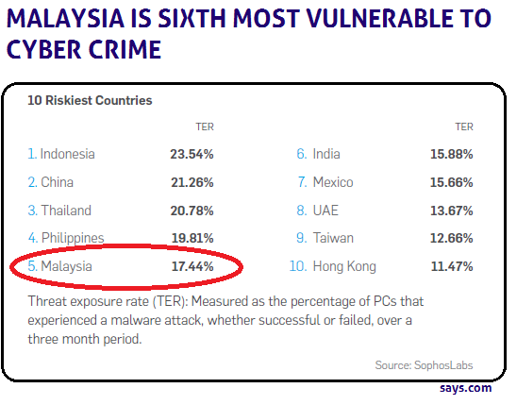

Slide 50
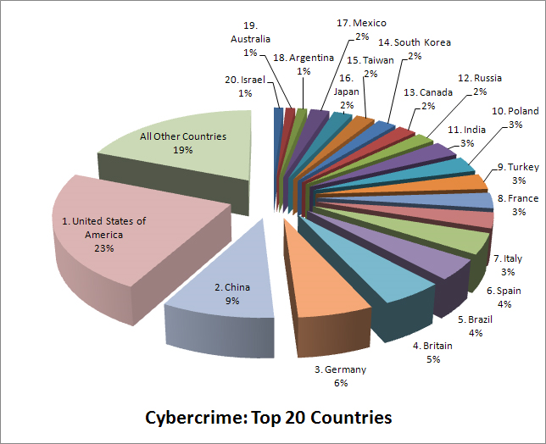
Top 20 Countries with the highest rate of Cybercrime
(source: BusinessWeek/Symantec)

